Slide 1
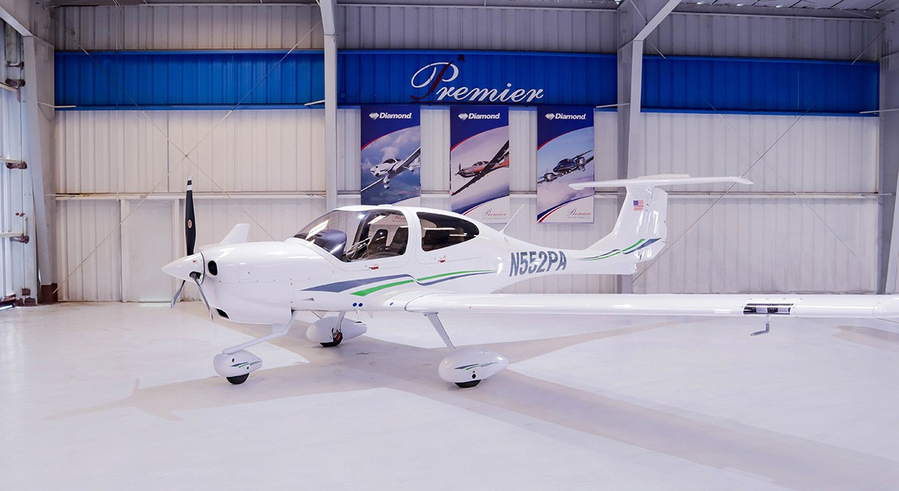

2024 Diamond DA40 NG
N552PA – SN 40.NC322
Take me home and fly me forever! Brand new DA40 NG with air conditioning and all the other creature comforts a pilot dreams about
Now with 3 years of spinner to tail warranty!!
Steven Vacek
817-818-9065
steven.vacek@flypas.com
www.premieraircraft.com

Slide 2

2024 Diamond DA40 NG
N552PA – SN 40.NC322
POWERPLANT
AVIONICS
OPTIONAL EQUIPMENT
Austro Engine AE300 Turbocharged Common-Rail Injected 2.0 Liter Diesel Engine with 168HP and EECU Single Lever Control System
Hartzell 3AQ00350STP Carbon Fiber Three Blade Propeller with Light-Weight "Bantam" Aluminum Hub
39 US gal (147 liter) Long Range Fuel Tank
Integrated Garmin G1000 NXi Glass Panel Cockpit including:
2x Garmin GOU 105x 10-inch Flight Display (PFD & MFD)
Garmin GEA 71B Airframe/Engine Interface Unit
Garmin Synthetic Vision Technology (SVT)
2x Garmin GIA 64W COM/NAV/SBAS-GPS /GS/LOC
Garmin GMA 1360 Digital Audio System
Garmin GRS 79 Attitude and Heading Reference System
Garmin GDC 72 Digital Air Data Computer
Garmin GMU 44 Magnetometer
Garmin FliteCharts Approach Plates (subscription required)
Garmin Flight Stream 510
ELT 406 MHz
Garmin GFC 700 Automatic Flight Control System
Garmin GTX 345R ADS-B “ln" /"Out” Transponder
Mid-Continent Digital Standby Altitude Module MD-302 SAM
Air Conditioning/RACC II System (powered by an additional alternator)
Now with 3 years of spinner to tail warranty!!
EXTERIOR
Allover white with green and silver striping
Beringer Wheels and Brakes
INTERIOR
Beige perforated Leather Seats
Dark Grey Premium Carpet
Light Grey Leather Headlines

Slide 3
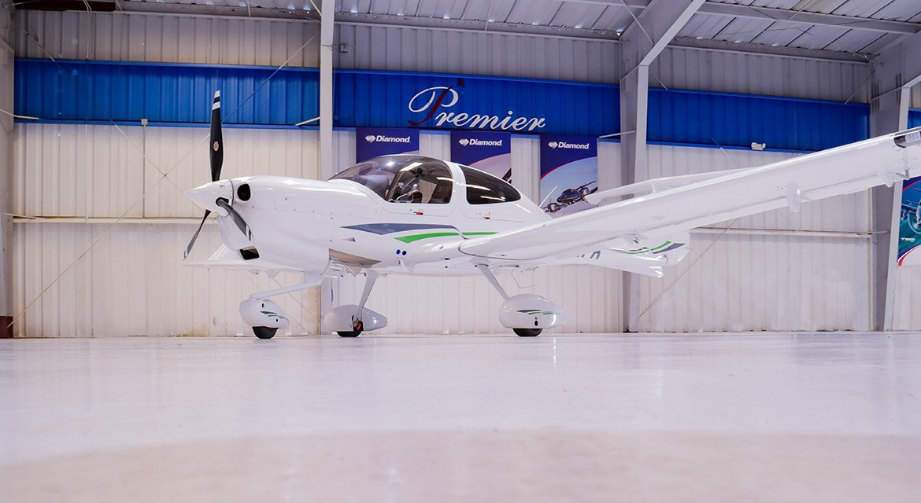

Slide 4
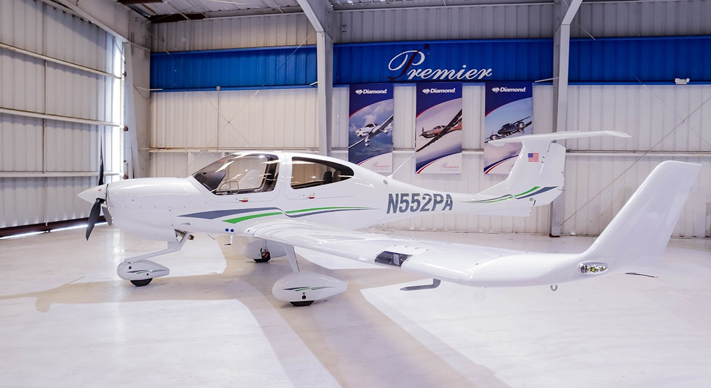

Slide 5
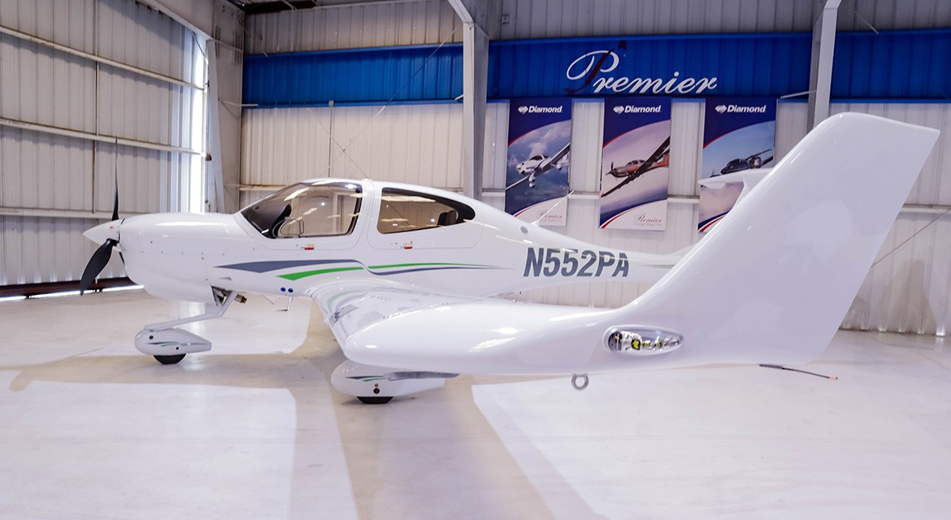

Slide 6
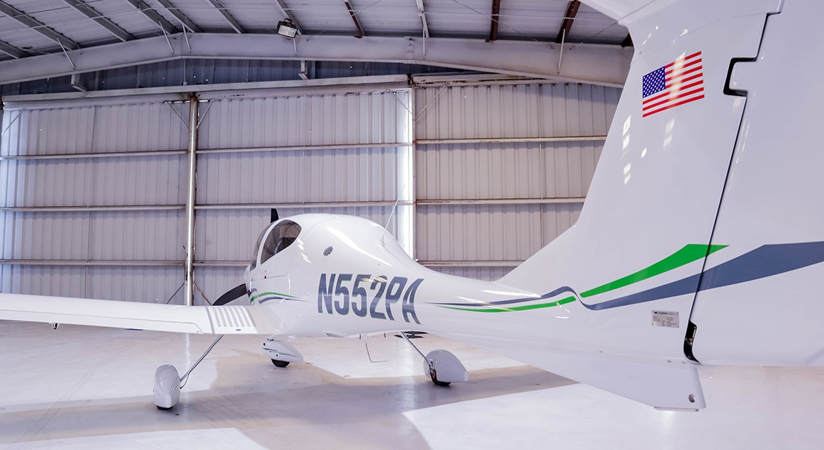

Slide 7
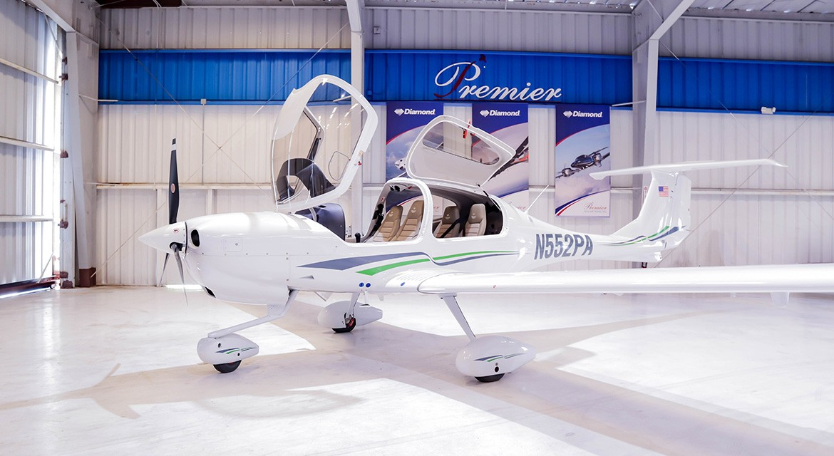

Slide 8
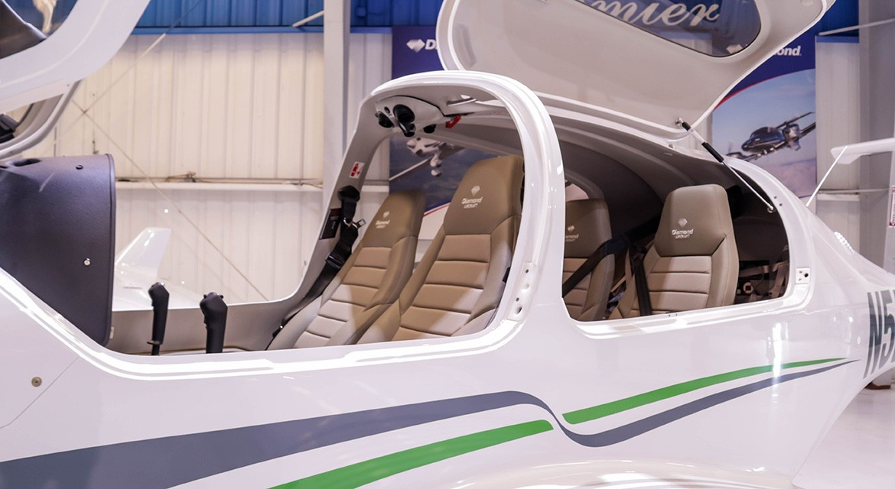

Slide 9
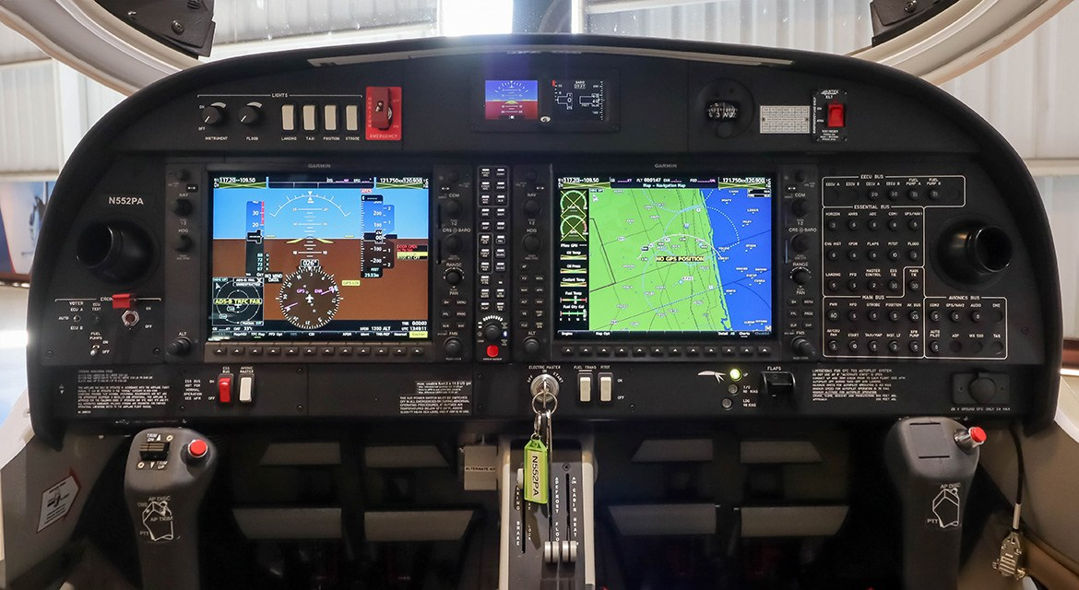

Slide 10
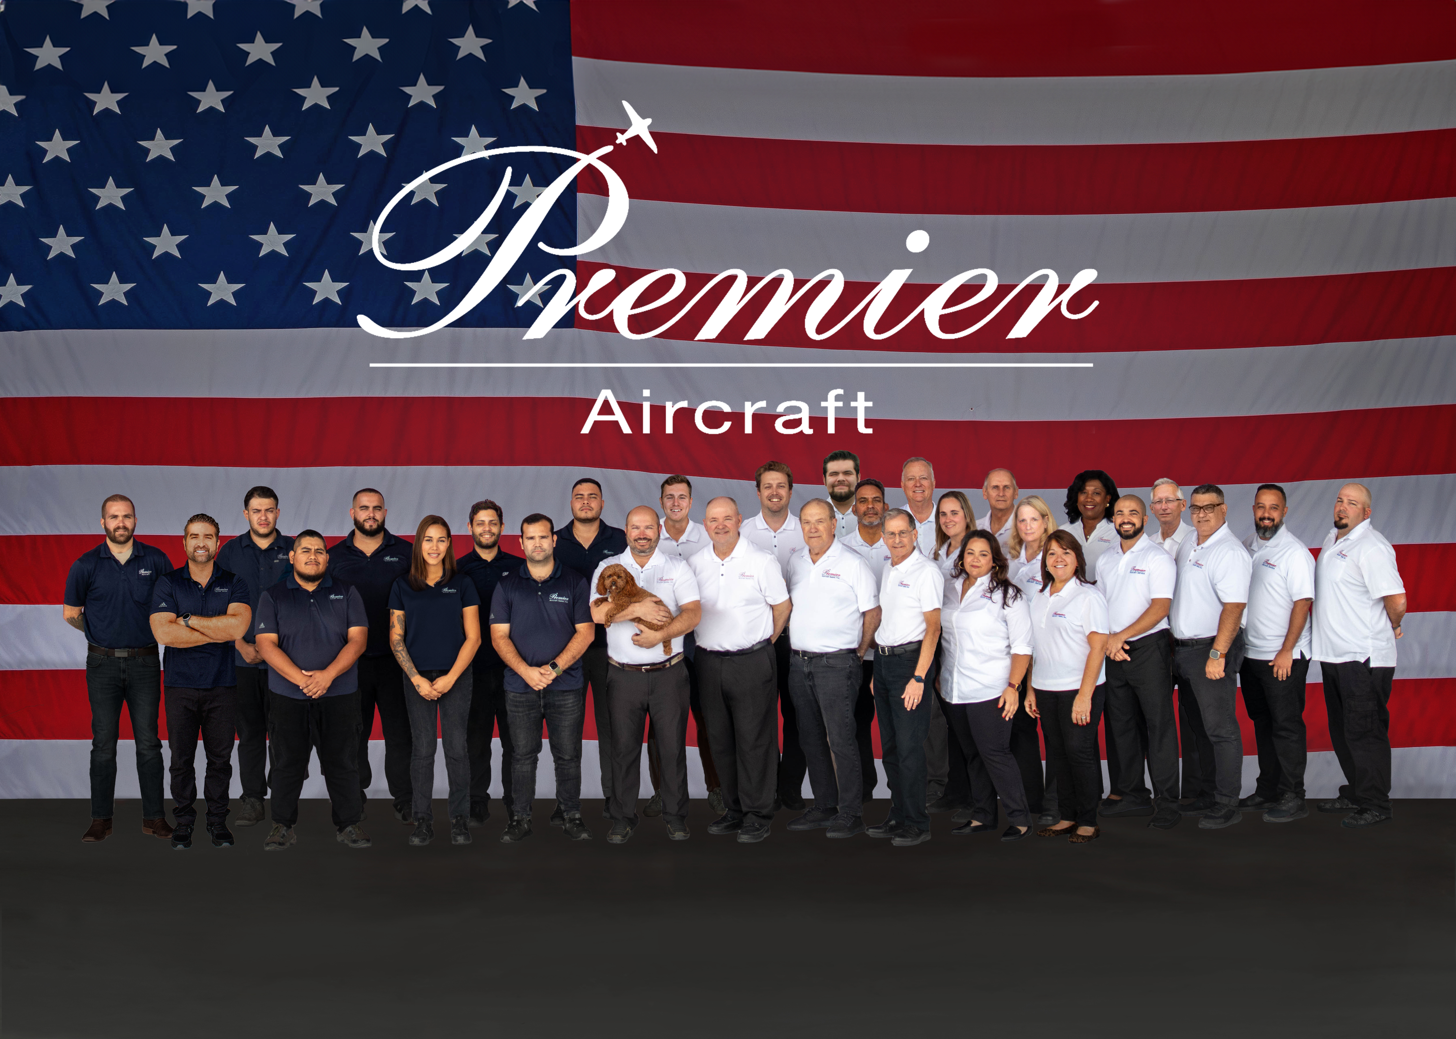

Slide 11
All specifications are subject to verification by buyer and subject to prior sale. Buyer is responsible to ensure that aircraft and its components are as described.
Fort Lauderdale Executive Airport (FXE)
5544 NW 23rd Avenue, Hangar 15
Fort Lauderdale, Florida 33309
954-771-0411

