Slide 1
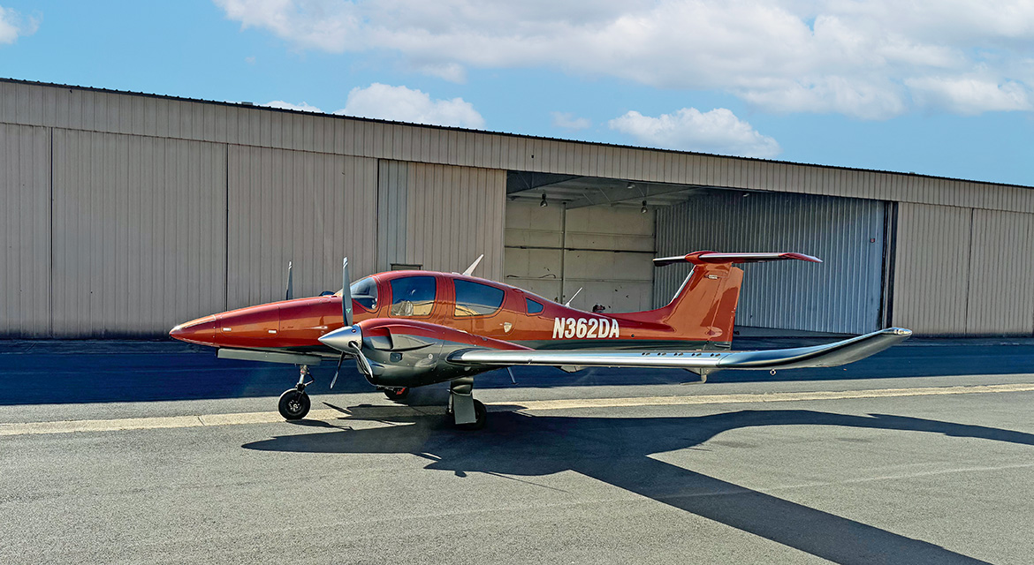
2023 DIAMOND DA62
N362DA – SN 62.C056
Jeff Owen
754-301-2476
jeff.owen@flypas.com
www.premieraircraft.com
One owner 2023 DA62, be the first to own a Garmin Phase 3,
GWX75 radar (upgrade to GWX8000 possible when certified), 5-seat configuration with FIKI Deice,
Air-conditioning, and more. Factory Warranty Until May 2025

Slide 2
2023 DIAMOND DA62 N362DA – SN 62.C056
STATUS
STANDARD AVIONICS
OPTIONAL EQUIPMENT
Total time, airframe, engines and props: 110 hours (times subject to change)
Annual completed: July 2025
MSB E4-043 fully complied so AD is not applicable
Full Aircraft Warranty until May 2025, or 1,000 hours
Air Conditioning/RACC II System (powered by an additional alternator)
TKS De-Icing system
Oxygen System
Built in Tablet Mounts
Integrated Garmin G1000 NXi Phase 3 Glass Panel Cockpit including.
2x Garmin GDU 105x 10-lnch Flight Display (PFD and MFD)
Garmin GEA 71B Airframe/Engine Interface Unit
2x Garmin GIA 64 W COM/NAV/SBAS-GPS/GS/LOC
Garmin GMA 1360 Digital Audio System
Garmin GRS 79 Attitude Heading Reference System
Garmin GDC 72 Digital Air Data Computer
Garmin GMU 44 Magnetometer
Garmin GFC 700 Automatic Flight Control System Including Yaw Damper
Garmin GTX 345R Remote-Mount ADS-B In/Out Transponder
Garmin Flight Stream 510
Garmin FliteCharts Approach Plates (Subscription required)
ELT 406 MHz
Mid Continent Digital Standby Altitude Mod
GWX75 radar (upgrade to GWX8000 possible when certified)
Garmin Synthetic Vision Technology (SVT)
STANDARD EXTERIOR
Diamond Premium Paint in Sunset Orange over Carbon Grey metallic
Hydraulic Retractable Landing Gear
Heated Pitot Tube and Static Port
86 US Gal (326 Lt) Long Range Fuel Tank
STANDARD INTERIOR
Diamond Deluxe Pearl Grey Leather interior
5-seat configuration (meets basic med requirements)
Electrically Adjustable Rudder Pedals for Pilot/Copilot
Sunvisors for Pilot and Copilot

Slide 3
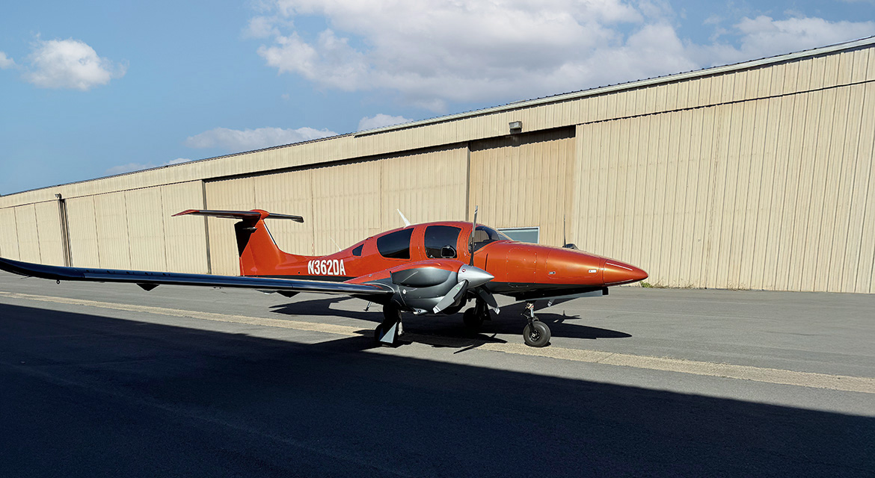

Slide 5
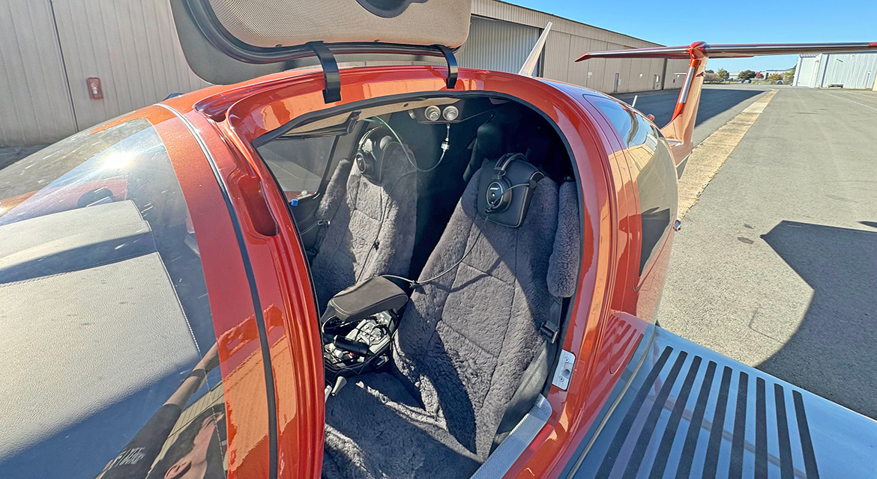

Slide 6
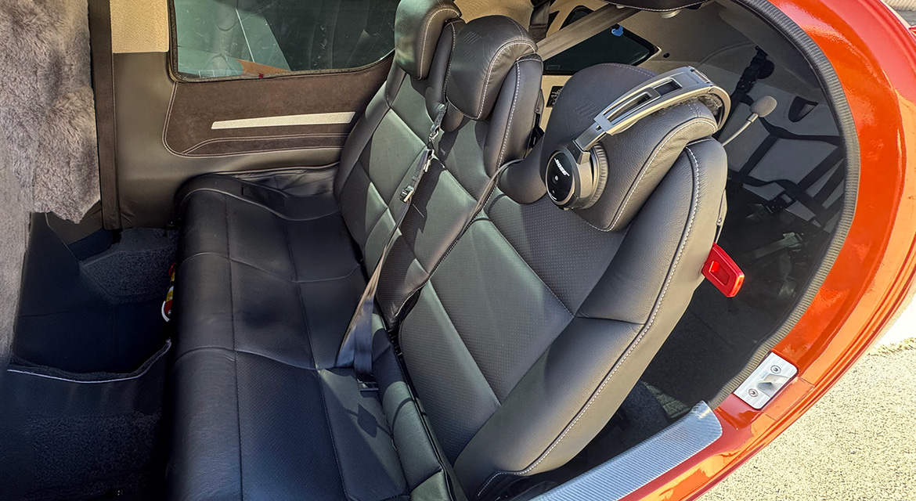

Slide 7
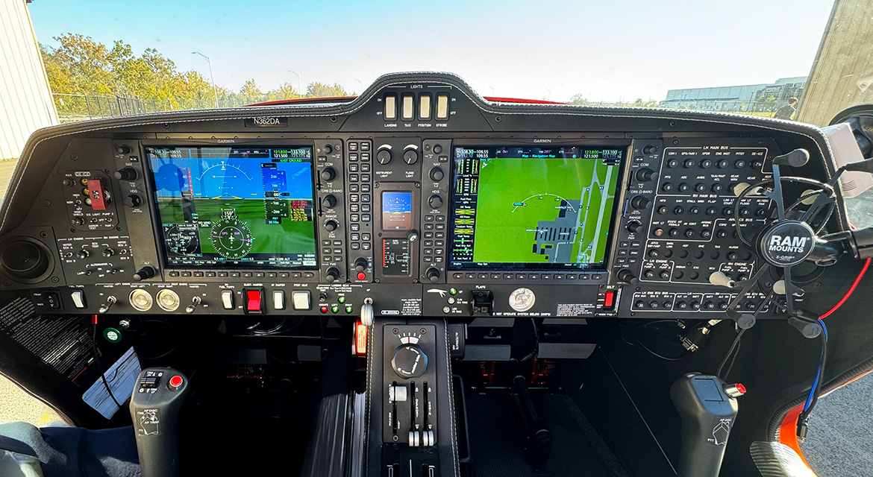

Slide 9
All specifications are subject to verification by buyer and subject to prior sale. Buyer is responsible to ensure that aircraft and its components are as described.
Fort Lauderdale Executive Airport (FXE)
5544 NW 23rd Avenue, Hangar 15
Fort Lauderdale, Florida 33309
954-771-0411

